Slide 1
INTRODUCTION
Hello I Am Shubham Dabi, and Welcome. In this Presentation, I will take you through our Company’s Sales Performance for the years 2010 and 2011.
I appreciate the opportunity you gave me to dive into this data to gain insightful information about the store’s Performance.
Thank you also for the Questions you asked since they provided a general direction for the kind of insights you are looking to get from this Analysis.

Slide 2
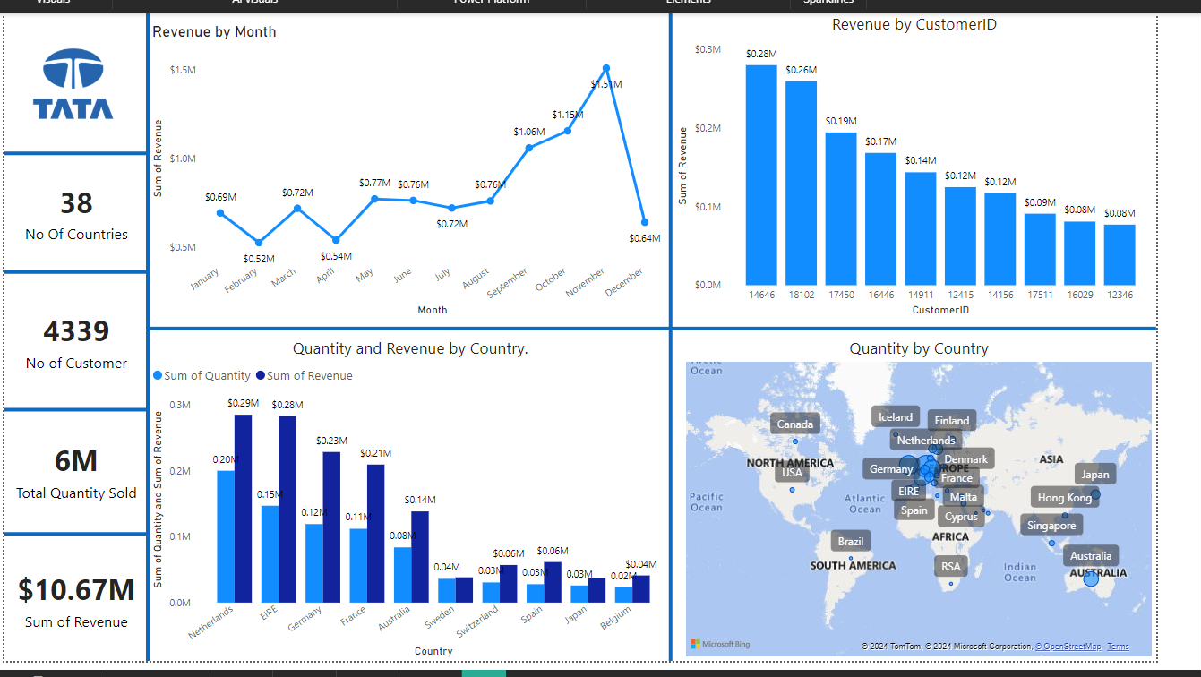

Slide 3
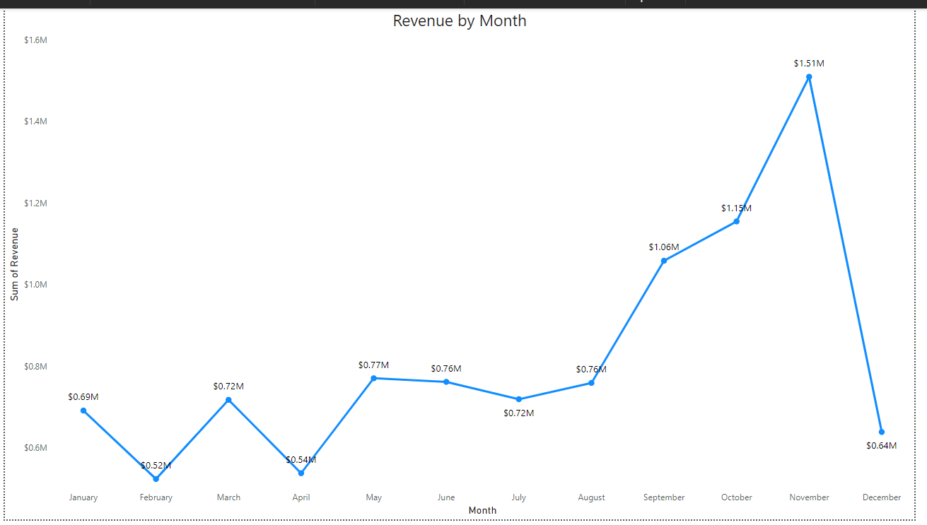

Slide 4
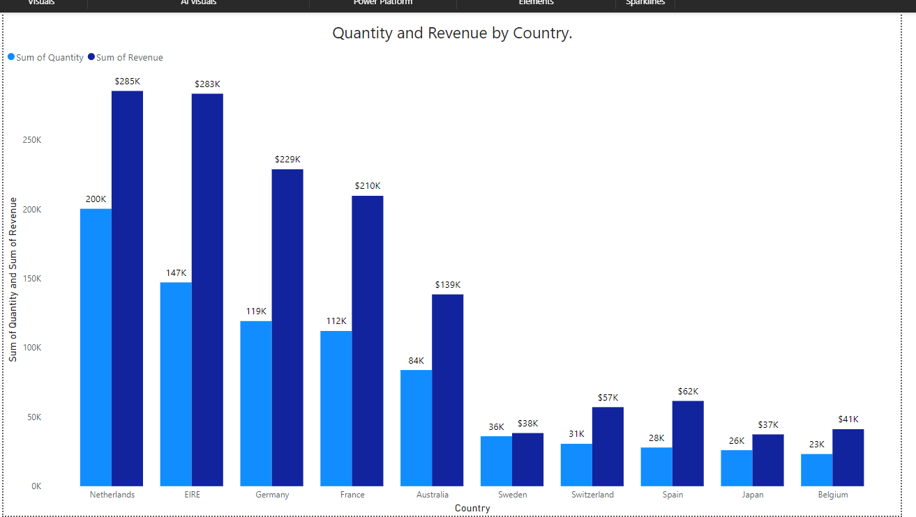

Slide 5
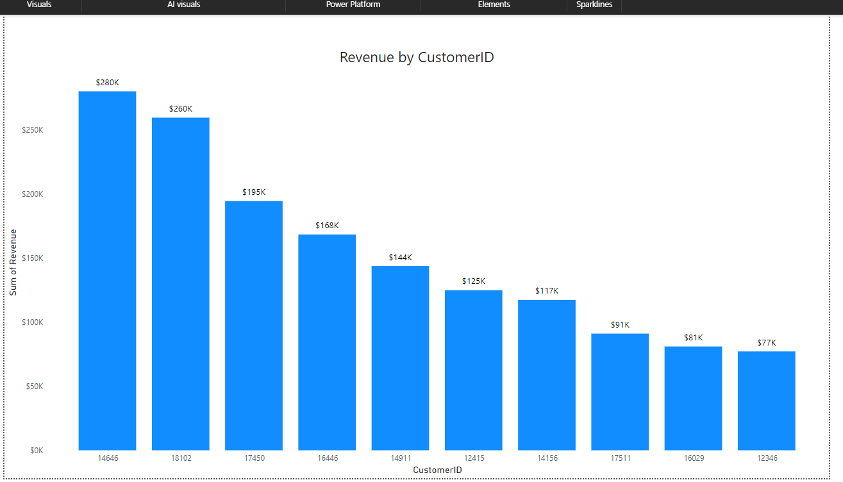

Slide 6
